Slide 1
Day and night
Presenting By Sushil Varma.

Slide 2

When we have the sun shining in the sky it is a day
When we don’t have it’s night

Slide 3


Day time is from the time of the sunrise until sunset

Slide 4

Night time is from the time of the sunset’s until sunrise’s

Slide 5
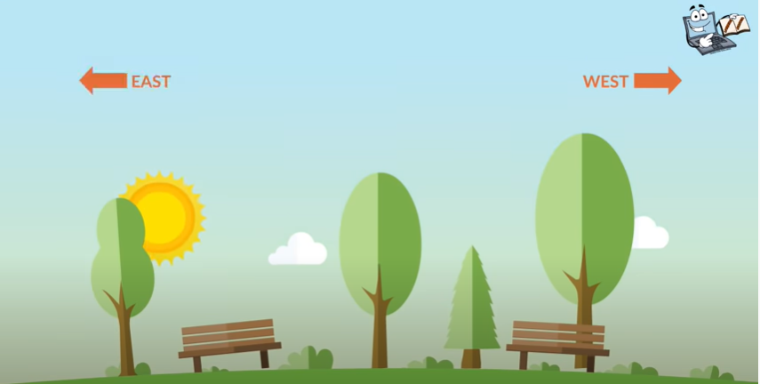
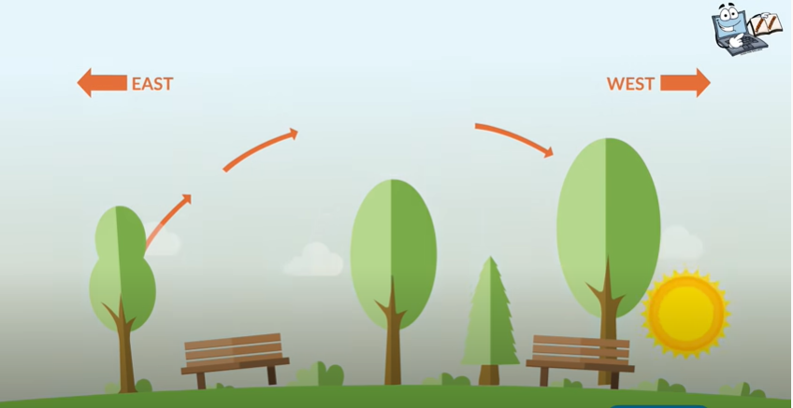
Sunrises at East side
Sunset at West side

Slide 6
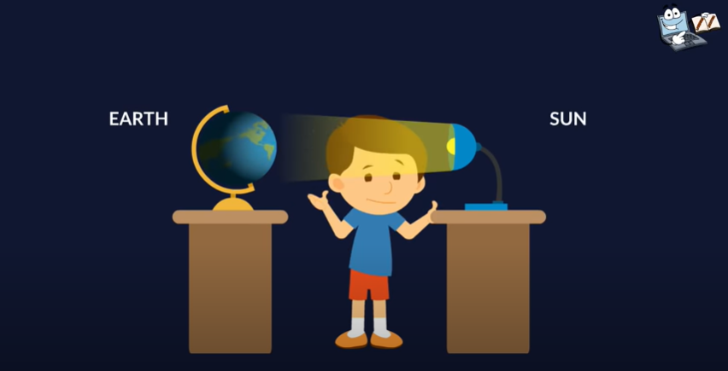

Day
Night

Slide 7

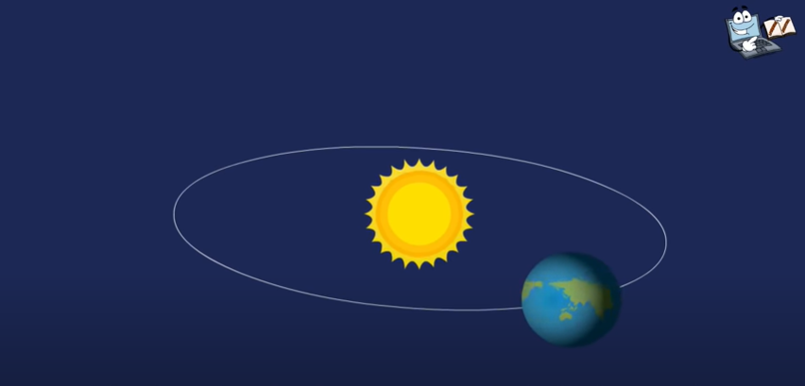
The sun appears to move across the sky because the earth rotates on its axis.
Axis is a imaginary straight line passing through the North pole, the centre of the Earth and the South pole
The Moment of the Earth on its own axis is known as a rotation
When the Earth rotates the day changes to night and night changes to day.
It takes 24 hours for the Earth to complete one rotation.

Slide 8
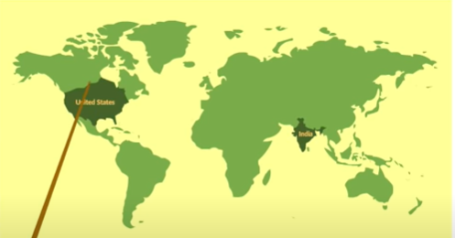
there are two countries India and united states opposite sides on the map
That’s why when in India there is a night in united states there is a day.
When in India there is day , in united states there is a night

Slide 9
Thank you

